Slide 1
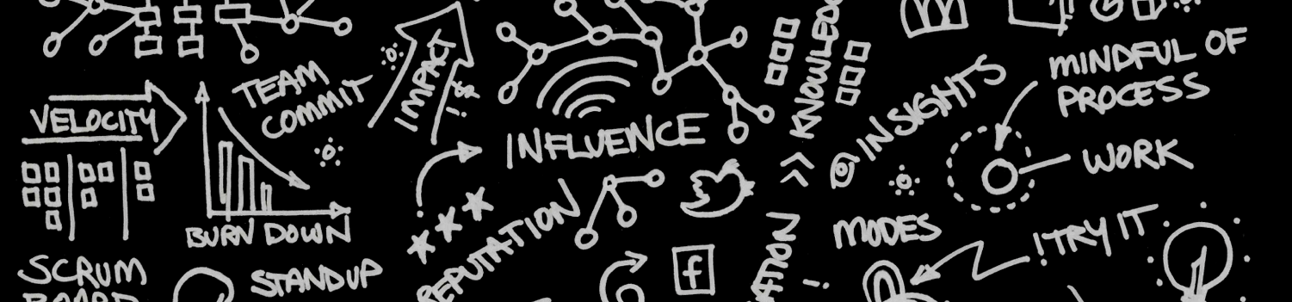
Journey Mapping – Designing your experience
Everything you need to take the 2nd step in Journey Mapping

Slide 2
This presentation is designed for a Journey Mapping Facilitator and/or event sponsor that have already experienced a Journey Mapping “Learn” event and want to move to the next step by implementing a “Design” session.
We seek to provide you with tools and techniques you might need to keep moving forward with your customer centered transformation.
If you have any questions, the team at Oracle is eager to help. designingcx.com

Slide 3
What’s in this presentation?
1
Goals & overview of a Journey Mapping “Design” session
Preparing for your session
Running your session
Sample materials: Personas, Metrics, etc.
2
3
4

Slide 4
Goals & overview
1

Slide 5
What are the Goals?
1
Primary Goal: Experience how Journey Mapping will work for your customers & your business
Expand the reach & prepare internal teams to apply CXJM in your day to day business
Identify projects that are worth pursuing

Slide 6
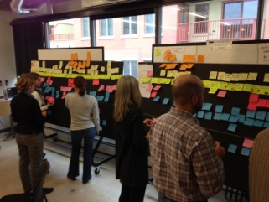
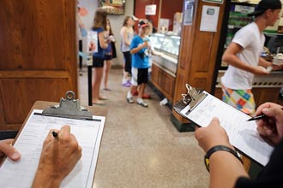


1
CXJM Starts Customer Centric Transformations
Journey Mapping can be your on ramp to creating a culture of customer centered transformation
Learn CXJM
Design CXJM
Execute
Identify Need
Share
Teach
Recommend
Customer persona used
on a portion of your lifecycle
Generic Scenario to learn basic methodology
Disciplined & Validated
Test Methodology
The methodology should be learned before first before using it on your business to design new experiences, and then executing it with validated data and insights

Slide 7
1
CXJM Starts Customer Centric Transformations
Learn CXJM
Design CXJM
Execute
Identify Need
Share
Teach
Recommend
Customer persona used
on a portion of your lifecycle
Generic Scenario to learn basic methodology
Disciplined & Validated
Test Methodology
Using Journey Mapping to Design new experiences is a critical step before execution as part of customer centric transformation efforts

Slide 8
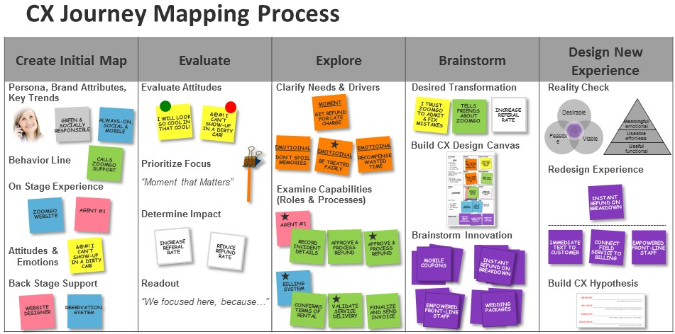
The 3 Key Differences for the “Design” step
1
It’s the same process as the Jen/ZoomGo scenario, with 3 changes
1) Use or build a persona, review brand attributes, document key trends
2) Create a custom behavior line that will be the basis for your map
3) Develop your own impact metrics

Slide 9
Preparing for your session
1
Goals & overview
2
Running your session
3
Sample materials
4

Slide 10
Begin Preparation
2
Start 2-3 weeks before your session
2-3 Weeks Prior 1 Week Prior 1 Day Prior
Build persona(s)
Select portions of the lifecycle for each board
Identify 12-24 participants
Enlist coaches*
Order Materials
Create scaffolding for action line, impact metrics, brand
Print blank canvas & hypothesis sheets
Finalize your agenda & time blocking
Meet with coaches for final pre-flight check
Customize the presentation PowerPoint deck
Set up room & materials
* Oracle may be able to help provide coaches if there aren’t enough trained coaches at your organization

Slide 11
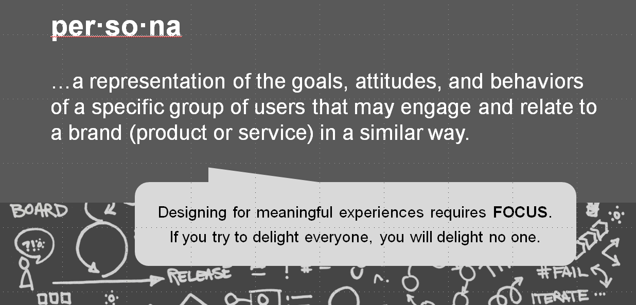
Start By Creating Persona(s)
2

Slide 12



Market Segments & Personas
2
Journey maps are based on a persona, not a segment
Persona
Segment
SEGMENT A
Urban Homeowners Male 18-49
With 1+ Dog(s)
Research-driven
Used to design experiences
Representative of an individual customer
Relatable & real
May belong to one of your segments
Can be described in detail
Clearly identified groupings that can be measured
Emphasis on analytics / BI
Used to execute & measure
Marketing accessibility (you can reach them)
Aggregated, impersonal description of a group
SEGMENT B
Suburban Homeowners
Married Males
With 2+ Dogs
Humanize & Connect
Analyze & Size an opportunity

Slide 13
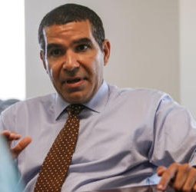
Define Your Persona
2
PROFILE | Location | Where does he/she live & work?
 | Professional | What is their job? If B2B, add detail on role in decision making, influence, responsibilities
 | Education | Level and kind of schooling completed
BEHAVIORS | Usage & loyalty | Type of usage, online stats, how they engage with us, behavior, usage rate, how loyal
 | Attitude & Beliefs | What does he/she think of us? The category?
 | Lifestyle | Social group, status, openness to innovation, media habits, proficiency
 | Interests & Hobbies | What does he/she do in their free time, how important is that to them?
NEEDS | Usage Goals | What is she/he looking to accomplish? How important is it to them?
 | Emotional Goals / Quote | What is at stake emotionally? What would a quote in their words say?
 | Motivations & Triggers | What motivates him/her, what makes them tick?
Add a photo
<Name>
<Age>
(See samples in section 4 and on the following slide)

Slide 14

Sample Persona
2
PROFILE | Location | Los Angeles, CA
 | Professional | College Sophomore, studying psychology, planning to attain her masters degree
 | Education | In 2nd year of college
BEHAVIORS | Usage & loyalty | Mobile first for all her banking, ATM second, rarely uses a PC/Mac to access her account, only went into a branch to open her account. Deposits check(s) via mobile app once per week.
 | Attitude & Beliefs | She views us as local and involved in the community; she is ambivalent toward most banks
 | Lifestyle | Socially active but not obsessed, prefers action to talk, expects ease of use as baseline, watches 2 hours of TV via web & iPad apps, proficient across many digital devices
 | Interests & Hobbies | Spends time with friends, going to restaurants, hiking, working out at the gym
NEEDS | Usage Goals | She doesn’t want to have to worry about her finances. She expects us to help her make it simple.
 | Emotional Goals / Quote | “I want to be able to pay all my bills without having to worry, and not obsess over financial goals.”
 | Motivations & Triggers | She cares about her friends, family, and wants to give back
Lindsay
Age: 20
Student

Slide 15

Select a Portion of the Lifecycle
2
This is the foundation on which each behavior line is built
Purchase Scenario
Select a portion of the lifecycle that relates well to the persona(s) you have selected
Aim for enough detail for roughly 15-25 steps on the behavior line (so it will span an 8’ board)
Scenarios can span more than one board but our recommendation is to have a discrete scenario on each board
4
8
Support Scenario
BUY
OWN
3
7
Market & Sell
Support & Serve
1
5
2
6

Slide 16


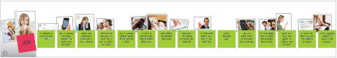
Preparation Options
2
The extent of your preparation will impact your mapping activity
Assumptive Pre-work
Research Anchored Pre-work
Deep research-driven personas
Create a simple assumptive persona
Both approaches can work well
Create a scaffold of behavior lines after creating a quick assumptive behavior line
Build full behavior lines in advance with input from multiple parties
Customer sees online offer for high speed Internet
Customer initiates order online
Calls customer service to ask about installation fee
Downgrades package to lower monthly cost

Slide 17
Building The Behavior Line
2
Good preparation here will return dividends in your group activity
We recommend that you frame out behavior lines for all your boards, then reduce them to 4-5 steps that provide a scaffold for the teams to have as a starting point
Provide 1st & last step, plus a few in the middle for each board
Write them out on green post-its® ahead of time
Initiates chat session to ask about charges on first bill
Calls and asks to speak to a supervisor
Is told that the minimum 12 month term can’t be changed
Shares negative experience on Facebook
Ends chat sessio
More behavioral detail
Additional action steps
Realizes situation unresolved
Ends chat sessio
More behavioral detail
Additional action steps
Realizes situation unresolved
Ends chat sessio
More behavioral detail
Additional action steps
Realizes situation unresolved

Slide 18
Preparing Impact Metrics
2
Impact Metrics lead to results, not just indicate activity
Bottom line results $
* Some advanced organizations have measured the financial impact for a 1% gain in their NPS metric. This is rare and organizations usually cannot quantify the link between KPIs and financial performance.

Slide 19

Preparing Impact Metrics
2
Impact Metrics lead to results, not just indicate activity
INCREASE CUSTOMER SATISFACTION
KPI
Unclear connection to measurable financial impact*
?
Bottom line results $
* Some advanced organizations have measured the financial impact for a 1% gain in their NPS metric. This is rare and organizations usually cannot quantify the link between KPIs and financial performance.

Slide 20

Preparing Impact Metrics
2
Impact Metrics lead to results, not just indicate activity
INCREASE CUSTOMER SATISFACTION
IMPACT METRIC
KPI
INCREASE REORDER RATE
Unclear connection to measurable financial impact*
?
Direct connection to measurable impact
Bottom line results $
* Some advanced organizations have measured the financial impact for a 1% gain in their NPS metric. This is rare and organizations usually cannot quantify the link between KPIs and financial performance.

Slide 21
Examples of Impact Metrics
2
Acquisition, Retention, & Efficiency gains
There’s a direct connection between these impact metrics and the financial bottom line
Acquisition Costs
Customer Retention
Improved Efficiency
Operational Efficiency

Slide 22
Examples of Impact Metrics
2
Acquisition, Retention, & Efficiency gains
There’s a direct connection between these impact metrics and the financial bottom line
INCREASE REFFERAL
RATE
Acquisition Costs
Customer Retention
Improved Efficiency
Operational Efficiency

Slide 23
Examples of Impact Metrics
2
Acquisition, Retention, & Efficiency gains
There’s a direct connection between these impact metrics and the financial bottom line
INCREASE REFFERAL
RATE
INCREASED REORDER %
Acquisition Costs
Customer Retention
Improved Efficiency
Operational Efficiency

Slide 24
Examples of Impact Metrics
2
Acquisition, Retention, & Efficiency gains
There’s a direct connection between these impact metrics and the financial bottom line
INCREASE REFFERAL
RATE
INCREASED REORDER %
DECREASE
DEFECT
RATE BY 2%
Acquisition Costs
Customer Retention
Improved Efficiency
Operational Efficiency

Slide 25
Examples of Impact Metrics
2
Acquisition, Retention, & Efficiency gains
There’s a direct connection between these impact metrics and the financial bottom line
INCREASE REFFERAL
RATE
INCREASED REORDER %
DECREASE
DEFECT
RATE BY 2%
INCREASE FIRST CALL RESOLUTION
Acquisition Costs
Customer Retention
Improved Efficiency
Operational Efficiency

Slide 26
Attributes of Desirable Experiences
2
How does your brand line up with these attributes?
USEFUL
(function)
USEABLE
(effort)
MEANINGFUL
(emotion)
Examples: Features Price Selection | Examples: Convenient Easy Intuitive | Examples Stylish Reputable Trusted
What your product/service offers customers functionally
How easy is it to engage your organization and offerings
How meaningful experiences are at an emotional level

Slide 27
Document Your Brand Attributes
2
Describe what your brand stands for in these 3 areas
USEFUL
(function)
USEABLE
(effort)
MEANINGFUL
(emotion)
Premium priced | Intuitive | Trusted
What your product/service offers customers functionally
How easy is it to engage your organization and offerings
How meaningful experiences are at an emotional level

Slide 28
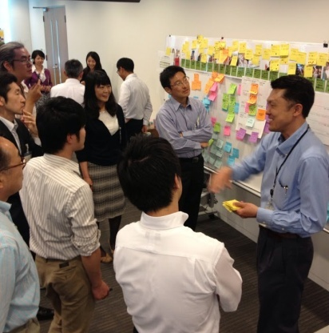
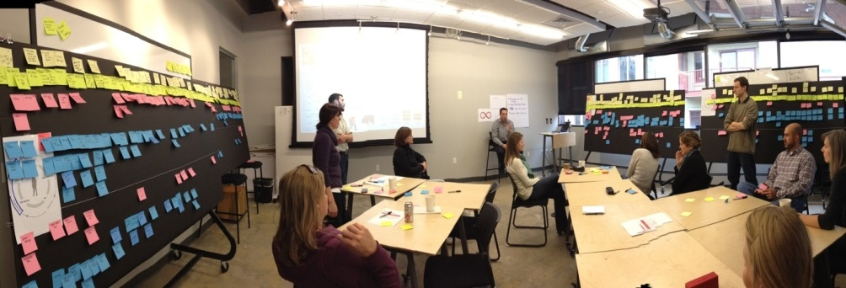
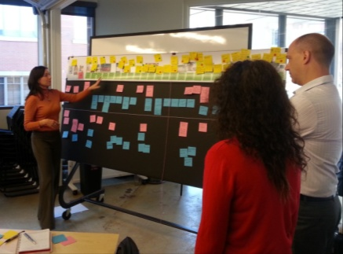
Selecting Workshop Participants & Coaches
2
Best Practice Suggestions
Minimum of 12 to 18 participants from a variety of departments
Use 3 Posters or 3 Boards with 4-6 participants per board
Have 1 experienced coach to lead each board
Tip: Journey Mapping “Design” sessions work best when individuals across departmental silos are involved and can build customer empathy together

Slide 29
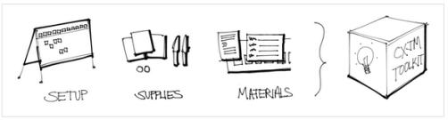
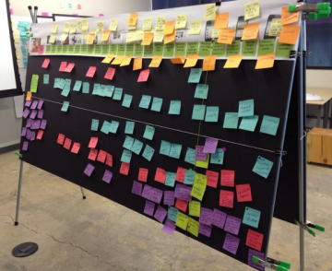
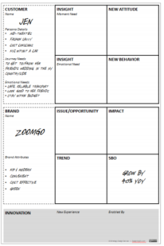


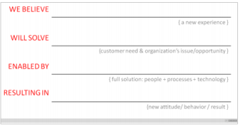

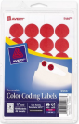



Getting Materials Ready
2
You’ll need the same kit as Jen & Zoomgo, with a few additions
Room Setup
Option 1
Supplies
Materials
Post-its®, pens, clips, voting stickers, string
4’ X 8’ ½” thick foam core boards
(1.4M x 2.4M x 1.3cm thick)
Blank Hypothesis Sheets
CX Design Canvas
Here’s a link to the list of all the materials you’ll need: http://designingcx.com/cx-journey-mapping-toolkit/
Our recommendation is to use foam core boards or other large physical media for the activity for 2 reasons: 1) experience has shown better results when teams can work across an 8’ surface to build their maps
2) sharing the story with others is enabled with boards, but often roll up maps are stored on a shelf, have less enduring impact

Slide 30
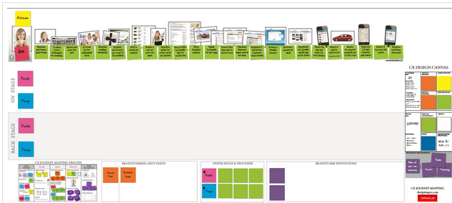
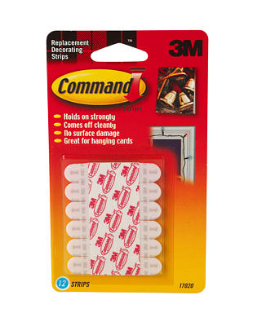
Getting Materials Ready
2
You’ll need the same kit as Jen & Zoomgo, with a few additions
Room Setup
Option 2
Supplies
Materials
4’ X 8’ roll up posters, laminated
Post-its®, pens, clips, voting stickers, string
Blank Hypothesis Sheets
CX Design Canvas
3M adhesive for
mounting on wall
Here’s a link to the list of all the materials you’ll need: http://designingcx.com/cx-journey-mapping-toolkit/
Our recommendation is to use foam core boards or Roll up posters for the activity for 2 reasons: 1) experience has shown better results when teams can work across an 8’ surface to build their maps
2) sharing the story with others is enabled with boards, but often roll up maps are stored on a shelf, have less enduring impact

Slide 31


Getting Materials Ready
2
Alternate Working Surface – 3rd Choice
If it is difficult to find and purchase foam core boards or print poasters an alternate surface for journey mapping is a roll of butcher paper and masking tape.
You’ll need flat sections of wall that are 8 feet or more for each map you’re planning to create. The printed Jen / ZoomGo behavior lines are each 8 feet in length.
Masking
Tape
Butcher Paper
+
The question of whether to just use a whiteboard with post-it® notes sometimes comes up. We don’t recommend this approach since you’ll be unable to preserve the work you’ve done after your journey mapping session.

Slide 32
Plan Your Day
2
High-level and detailed agendas are required
Set a high level agenda for participants
Begin with Jen/ZoomGo “Learn” session to teach methodology
Follow with your custom “Try” session using your persona & scenario
Use the Excel tool to build a minute by minute time blocking so the facilitator can keep the group on track
Facilitator’s time blocking spreadsheet
Participant Agenda
Our recommendation is to ‘Learn’ the methodology on day 1, and devote day 2 to Try it on your business 1) It takes time to both learn and integrate a new methodology. Teams start day 2 refreshed and ready
2) You’ll have a greater chance of developing actionable innovations if you have adequate time in a Try session

Slide 33
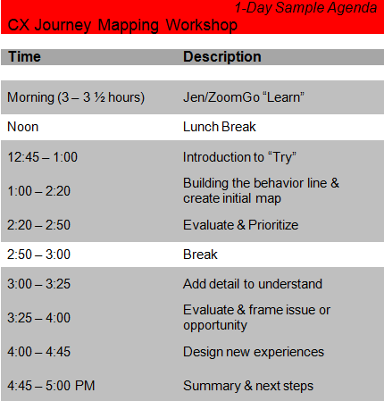
Plan Your Day - options
2
Alternate time schedules for compressed Design sessions
1-Day
1 ½ -Day
Recommended
Running a 1-day session will give participants a taste for journey mapping, but is less likely to yield actionable projects and will not fully prepare them to use journey mapping in their day to day work

Slide 34
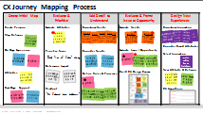

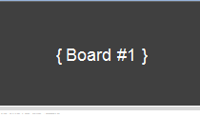
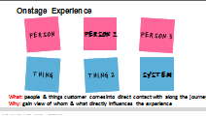
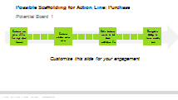
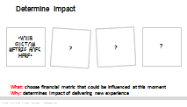
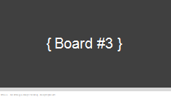
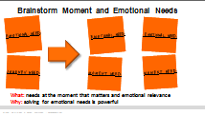
Customize The PowerPoint Slides
2
Customize our standard PPT presentation for your scenarios
The areas we suggest you customize are:
Lifecycle focus areas (slide 5)
Personas (slide 6)
Board #1-3 scaffolding (slides 7-12)
Slides that have post-its® with examples:
On-stage people & things (slide 16)
Back stage people & things (19)
Attitudes (18, 22, 23)
Impact metrics (25)
Needs (28, 33)
Roles & Processes (30, 34)
Innovations (38, 40)
New Attitudes & Behaviors (42)
CX Design Canvas – both the customer and brand sections on the left side need to be filled in with your brand information and the persona you’re working with
“Design” PowerPoint Slides: www.designingcx.com

Slide 35

Preparation Checklist
2
Make sure you are ready to go…
Create persona(s)
Select portions of the lifecycle for each board
Create scaffolding for action line (or create complete line)
Select Impact Metrics
Document Brand Attributes
Select 12-18 participants
Enlist 3 coaches
Get materials ready (Boards/Posters, supplies, materials)
Finalize your agenda & time blocking
Customize the presentation slides
Meet with your coaches beforehand

Slide 36
Running your session
1
Goals & overview
Preparing for your session
2
3
Sample Materials
4

Slide 37
Kicking It Off
3
Setting expectations for the day
Lay the foundation by explaining why you’re teaching the methodology first, then trying it on your business next
Explain the overall goal of driving customer centric transformation and the Learn, Try, Apply model
Select teams for the boards that might not usually work together
Try to keep the energy level up, and make it fun for the participants

Slide 38
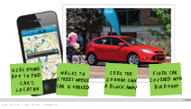
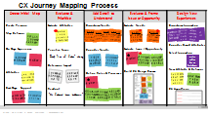
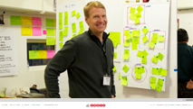
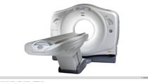
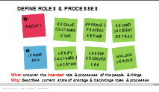

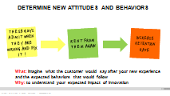
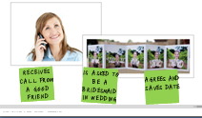
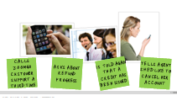

Run The “Learn” Jen & ZoomGo Story
3
Focus on helping everyone get solid on the methodology
Teach the methodology & encourage customer empathy

Slide 39
Run the “Design” Activity
3
Prove that Journey Mapping will work on your business
Use your customized PPT and the Excel time blocking to guide you
Creating the behavior line will be the most important and difficult part of the day
Keep things moving, work to keep things in synch across the 3 groups

Slide 40
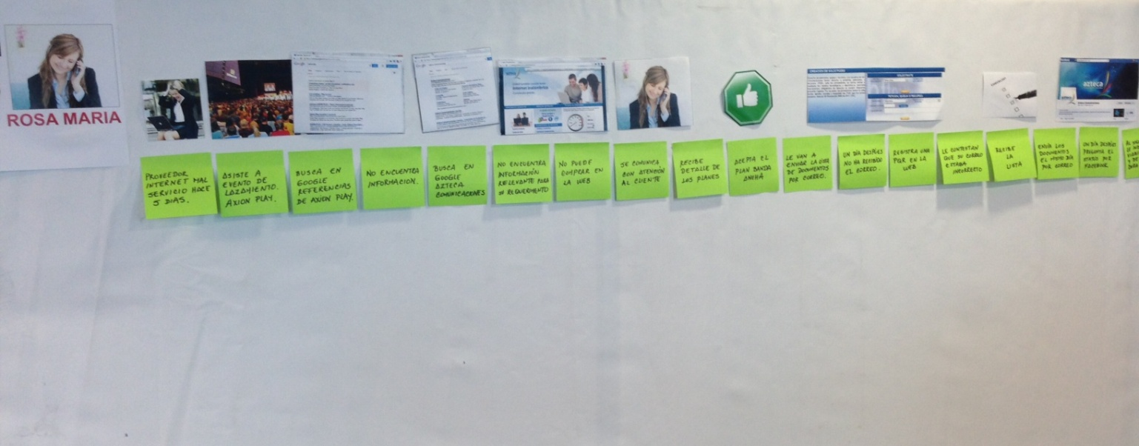
Behavior Line Group Technique
3
How to get input from the entire room
When 3 teams are working on 3 boards it is often worthwhile to conduct a read out once behavior lines have been created. Since there is likely specific expertise and insight spread around the room, it is wise to allow others to make suggestions on what behaviors might have been omitted as part of the customer’s journey
Each team completes 25-step behavior line
First team reads their persona description, then reads out the behavior line steps
The participants from other teams each write behaviors that they think might fit in the story on green post-its®, and place them beneath the line
Repeat the process for the next 2 boards
Teams review the input they received and decide whether to incorporate it on their board
Step suggested by other team member
Step suggested by other team member
Step suggested by other team member

Slide 41
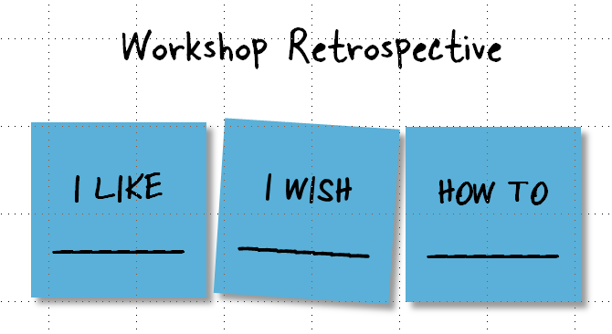
Wrapping Up
3
Solicit feedback, set next steps for action
Sample questions to ask:
Did we discover that Journey Mapping will work on our business?
Were any innovations/projects identified that we should pursue further?
Could you see using Journey Mapping day-to-day?
Next Steps – What Now??
We suggest you hold a meeting at the conclusion of the event with key stakeholders to discuss:
Any innovations or projects that were identified and should be worked on
If and how to move to the “Apply” step of CX transformation

Slide 42
SAMPLE MATERIALS
1
Goals & overview
Preparing for your session
2
Running your session
3
4

Slide 43
Sample Persona
2
PROFILE | Location | Los Angeles, CA
 | Professional | College Sophomore, studying psychology, planning to attain her masters degree
 | Education | In 2nd year of college
BEHAVIORS | Usage & loyalty | Mobile first for all her banking, ATM second, rarely uses a PC/Mac to access her account, only went into a branch to open her account. Deposits check(s) via mobile app once per week.
 | Attitude & Beliefs | She views us as local and involved in the community; she is ambivalent toward most banks
 | Lifestyle | Socially active but not obsessed, prefers action to talk, expects ease of use as baseline, watches 2 hours of TV via web & iPad apps, proficient across many digital devices
 | Interests & Hobbies | Spends time with friends, going to restaurants, hiking, working out at the gym
NEEDS | Usage Goals | She doesn’t want to have to worry about her finances. She expects us to help her make it simple.
 | Emotional Goals / Quote | “I want to be able to pay all my bills without having to worry, and not obsess over financial goals.”
 | Motivations & Triggers | She cares about her friends, family, and wants to give back
Lindsay
Age: 20
Student

Slide 44

Sample Persona (B2B)
4

Slide 45

Sample Persona (B2B)
4

Slide 46
DISCUSSION - Business Metrics
Need Phase – Organization’s Perspective:
“When a customer has a need for a product or service, are they aware of our brand?”
PURCHASE
RECOMMEND
8
Example KPI
4
SELECT
3
BUY
OWN
7
MAINTAIN
1
5
Example Financial Measure
2
6
RESEARCH
RECEIVE
NEED
USE

Slide 47
DISCUSSION - Business Metrics
Need Phase – Organization’s Perspective:
“When a customer has a need for a product or service, are they aware of our brand?”
PURCHASE
RECOMMEND
8
Example KPI
4
ADVERTISING REACH AND FREQUENCY
SELECT
3
BUY
OWN
7
MAINTAIN
1
5
Example Financial Measure
2
6
RESEARCH
RECEIVE
NEED
USE

Slide 48
DISCUSSION - Business Metrics
Need Phase – Organization’s Perspective:
“When a customer has a need for a product or service, are they aware of our brand?”
PURCHASE
RECOMMEND
8
Example KPI
4
ADVERTISING REACH AND FREQUENCY
SELECT
3
BUY
OWN
7
MAINTAIN
1
5
Example Financial Measure
RETURN ON ADVERTISING SPEND
2
6
RESEARCH
RECEIVE
NEED
USE

Slide 49
ACTIVITY – Business Metrics
Research Phase – Organization’s Perspective:
"When a customer begins their research, do they know our products or services could meet their needs?"
PURCHASE
RECOMMEND
8
Example KPI
4
SELECT
3
BUY
OWN
7
MAINTAIN
1
5
Example Financial Measure
2
6
RESEARCH
RECEIVE
NEED
USE

Slide 50
ACTIVITY – Business Metrics
Research Phase – Organization’s Perspective:
"When a customer begins their research, do they know our products or services could meet their needs?"
PURCHASE
RECOMMEND
8
Example KPI
4
INTERACTION RATE
SELECT
3
BUY
OWN
7
MAINTAIN
1
5
Example Financial Measure
2
6
RESEARCH
RECEIVE
NEED
USE

Slide 51
ACTIVITY – Business Metrics
Research Phase – Organization’s Perspective:
"When a customer begins their research, do they know our products or services could meet their needs?"
PURCHASE
RECOMMEND
8
Example KPI
4
INTERACTION RATE
SELECT
3
BUY
OWN
7
MAINTAIN
1
5
Example Financial Measure
NUMBER OF OPPORTUNITIES
2
6
RESEARCH
RECEIVE
NEED
USE

Slide 52
ACTIVITY – Business Metrics
Select Phase – Organization’s Perspective:
"What did our customer select, and how does it contribute to a financial benefit for us?"
PURCHASE
RECOMMEND
8
Example KPI
4
SELECT
3
BUY
OWN
7
MAINTAIN
1
5
Example Financial Measure
2
6
RESEARCH
RECEIVE
NEED
USE

Slide 53
ACTIVITY – Business Metrics
Select Phase – Organization’s Perspective:
"What did our customer select, and how does it contribute to a financial benefit for us?"
PURCHASE
RECOMMEND
8
Example KPI
4
UP-SELL / CROSS-SELL RATE
SELECT
3
BUY
OWN
7
MAINTAIN
1
5
Example Financial Measure
2
6
RESEARCH
RECEIVE
NEED
USE

Slide 54
ACTIVITY – Business Metrics
Select Phase – Organization’s Perspective:
"What did our customer select, and how does it contribute to a financial benefit for us?"
PURCHASE
RECOMMEND
8
Example KPI
4
UP-SELL / CROSS-SELL RATE
SELECT
3
BUY
OWN
7
MAINTAIN
1
5
Example Financial Measure
AVERAGE ORDER SIZE
2
6
RESEARCH
RECEIVE
NEED
USE

Slide 55
ACTIVITY – Business Metrics
Purchase Phase – Organization’s Perspective:
“How effective were we at getting our customers to convert?"
PURCHASE
RECOMMEND
8
Example KPI
4
SELECT
3
BUY
OWN
7
MAINTAIN
1
5
Example Financial Measure
2
6
RESEARCH
RECEIVE
NEED
USE

Slide 56
ACTIVITY – Business Metrics
Purchase Phase – Organization’s Perspective:
“How effective were we at getting our customers to convert?"
PURCHASE
RECOMMEND
8
Example KPI
4
CART ABANDONMENT RATE
SELECT
3
BUY
OWN
7
MAINTAIN
1
5
Example Financial Measure
2
6
RESEARCH
RECEIVE
NEED
USE

Slide 57
ACTIVITY – Business Metrics
Purchase Phase – Organization’s Perspective:
“How effective were we at getting our customers to convert?"
PURCHASE
RECOMMEND
8
Example KPI
4
CART ABANDONMENT RATE
SELECT
3
BUY
OWN
7
MAINTAIN
1
5
Example Financial Measure
REVENUE PER TRANSACTION
2
6
RESEARCH
RECEIVE
NEED
USE

Slide 58
ACTIVITY – Business Metrics
Receive Phase – Organization’s Perspective:
“How efficiently and effectively did we deliver our product or service?"
PURCHASE
RECOMMEND
8
Example KPI
4
SELECT
3
BUY
OWN
7
MAINTAIN
1
5
Example Financial Measure
2
6
RESEARCH
RECEIVE
NEED
USE

Slide 59
ACTIVITY – Business Metrics
Receive Phase – Organization’s Perspective:
“How efficiently and effectively did we deliver our product or service?"
PURCHASE
RECOMMEND
8
Example KPI
4
AVERAGE DELIVERY TIME
SELECT
3
BUY
OWN
7
MAINTAIN
1
5
Example Financial Measure
2
6
RESEARCH
RECEIVE
NEED
USE

Slide 60
ACTIVITY – Business Metrics
Receive Phase – Organization’s Perspective:
“How efficiently and effectively did we deliver our product or service?"
PURCHASE
RECOMMEND
8
Example KPI
4
AVERAGE DELIVERY TIME
SELECT
3
BUY
OWN
7
MAINTAIN
1
5
Example Financial Measure
DELIVERY COST PER TRANSACTION
2
6
RESEARCH
RECEIVE
NEED
USE

Slide 61
ACTIVITY – Business Metrics
Use Phase – Organization’s Perspective:
“How are our customers using our products or services?"
PURCHASE
RECOMMEND
8
Example KPI
4
SELECT
3
BUY
OWN
7
MAINTAIN
1
5
Example Financial Measure
2
6
RESEARCH
RECEIVE
NEED
USE

Slide 62
ACTIVITY – Business Metrics
Use Phase – Organization’s Perspective:
“How are our customers using our products or services?"
PURCHASE
RECOMMEND
8
Example KPI
4
RATE OF ADOPTION
SELECT
3
BUY
OWN
7
MAINTAIN
1
5
Example Financial Measure
2
6
RESEARCH
RECEIVE
NEED
USE

Slide 63
ACTIVITY – Business Metrics
Use Phase – Organization’s Perspective:
“How are our customers using our products or services?"
PURCHASE
RECOMMEND
8
Example KPI
4
RATE OF ADOPTION
SELECT
3
BUY
OWN
7
MAINTAIN
1
5
Example Financial Measure
VOLUME OVER TIME
2
6
RESEARCH
RECEIVE
NEED
USE

Slide 64
ACTIVITY – Business Metrics
Maintain Phase – Organization’s Perspective:
“Are we making it easy and effortless for customers to resolve their issues?"
PURCHASE
RECOMMEND
8
Example KPI
4
SELECT
3
BUY
OWN
7
MAINTAIN
1
5
Example Financial Measure
2
6
RESEARCH
RECEIVE
NEED
USE

Slide 65
ACTIVITY – Business Metrics
Maintain Phase – Organization’s Perspective:
“Are we making it easy and effortless for customers to resolve their issues?"
PURCHASE
RECOMMEND
8
Example KPI
4
SELF-SERVICE RATE
SELECT
3
BUY
OWN
7
MAINTAIN
1
5
Example Financial Measure
2
6
RESEARCH
RECEIVE
NEED
USE

Slide 66
ACTIVITY – Business Metrics
Maintain Phase – Organization’s Perspective:
“Are we making it easy and effortless for customers to resolve their issues?"
PURCHASE
RECOMMEND
8
Example KPI
4
SELF-SERVICE RATE
SELECT
3
BUY
OWN
7
MAINTAIN
1
5
Example Financial Measure
COST PER CHANNEL
2
6
RESEARCH
RECEIVE
NEED
USE

Slide 67
ACTIVITY – Business Metrics
Recommend Phase – Organization’s Perspective:
“How likely is it our customers will become advocates of our brand?"
PURCHASE
RECOMMEND
8
Example KPI
4
SELECT
3
BUY
OWN
7
MAINTAIN
1
5
Example Financial Measure
2
6
RESEARCH
RECEIVE
NEED
USE

Slide 68
ACTIVITY – Business Metrics
Recommend Phase – Organization’s Perspective:
“How likely is it our customers will become advocates of our brand?"
PURCHASE
RECOMMEND
8
Example KPI
4
REVENUE PER REFERRED CUSTOMER
SELECT
3
BUY
OWN
7
MAINTAIN
1
5
Example Financial Measure
2
6
RESEARCH
RECEIVE
NEED
USE

Slide 69
ACTIVITY – Business Metrics
Recommend Phase – Organization’s Perspective:
“How likely is it our customers will become advocates of our brand?"
PURCHASE
RECOMMEND
8
Example KPI
4
REVENUE PER REFERRED CUSTOMER
SELECT
3
BUY
OWN
7
MAINTAIN
1
5
Example Financial Measure
CUSTOMER CHURN RATE
2
6
RESEARCH
RECEIVE
NEED
USE

Slide 70
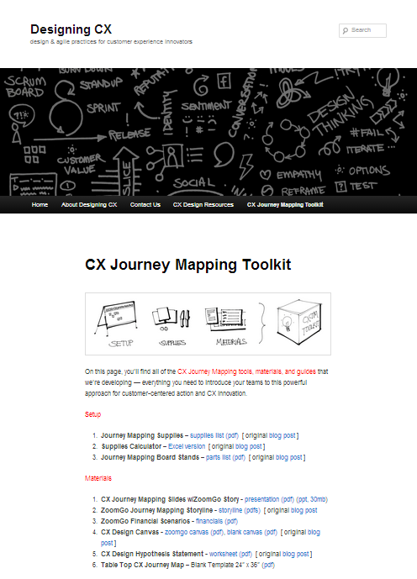
DESIGNINGCX.COM
Notes:
Download all of our latest materials from our CX Journey Mapping Toolkit on DesigningCX.com

